Slide 1
ZKP and Security for E-Voting Systems
24-25J-136

Slide 2
Introduction to the overall project
Electronic voting systems offer convenience and accessibility but face challenges related to privacy, security, and transparency. This research integrates Zero Knowledge Proofs (ZKP) and blockchain technology to overcome these issues and enhance e-voting systems.
Currently, 50% of the project has been successfully implemented, demonstrating significant progress in addressing the core challenges of e-voting systems. Key milestones achieved so far include:
Enhancing Voter Privacy: The integration of ZKP has been partially implemented, enabling the validation of votes without revealing voter identities or choices.
Ensuring Vote Integrity: Blockchain-based vote recording mechanisms have been established to ensure immutability, prevent tampering, and provide accurate vote counts.
Achieving Transparency and Verifiability: Initial steps toward enabling public verification of election results through a transparent, decentralized ledger have been realized, while maintaining voter confidentiality.
Optimizing Performance: The groundwork for employing zk-SNARKs to improve system efficiency and scalability has been laid, with ongoing optimization for large-scale election scenarios.

Slide 3

Research Question
How can the integration of Zero Knowledge Proofs (ZKP) and blockchain technology be leveraged to enhance the privacy, security, and transparency of electronic voting systems?

Slide 4
Objectives
Main Objective
The objective of this research is to develop a secure and verifiable electronic voting system by integrating Zero Knowledge Proofs (ZKP) and blockchain technology. This approach aims to enhance voter privacy, ensure vote integrity, and enable transparent election results.

Slide 5
Sub Objectives
Sub Objectives
Implement Zero Knowledge Proofs (ZKP) to validate votes without revealing voter identities, ensuring privacy and anonymity.
Integrate dynamic taint analysis to monitor and prevent unauthorized data access, enhancing the overall security of the voting system.
Utilize blockchain technology to create a tamper-proof ledger that records votes immutably, guaranteeing vote integrity and public verifiability.
Employ homomorphic encryption to allow encrypted vote aggregation and processing, maintaining confidentiality throughout the election process.

Slide 6

IT21361654 | Hussain m.r.s
Cyber Security
Secure and Scalable E-Voting System: ZKP & Blockchain
IT21361654 | Hussain M.R.S | 24-25J-136

Slide 7
Research Problem
Existing e-voting systems lack the necessary security and trust features for widespread adoption. We address this by exploring the use of ZKP and blockchain for a robust and transparent e-voting solution.
Privacy
Ensuring voter anonymity and protecting sensitive data.
Security
Mitigating threats like manipulation and fraud.
Scalability
Supporting large-scale elections efficiently.
IT21361654 | Hussain M.R.S | 24-25J-136

Slide 8
Objectives
Our project aims to build a secure and scalable e-voting system using ZKP and blockchain technology. We aim to address the inherent challenges of current e-voting systems and introduce a new standard for trust and integrity.
Main Objective
Secure and scalable e-voting system using ZKP and blockchain.
Sub-objective 1
Implement ZKP-based privacy for voter authentication.
Sub-objective 2
Integrate blockchain for secure vote storage.
IT21361654 | Hussain M.R.S | 24-25J-136

Slide 9
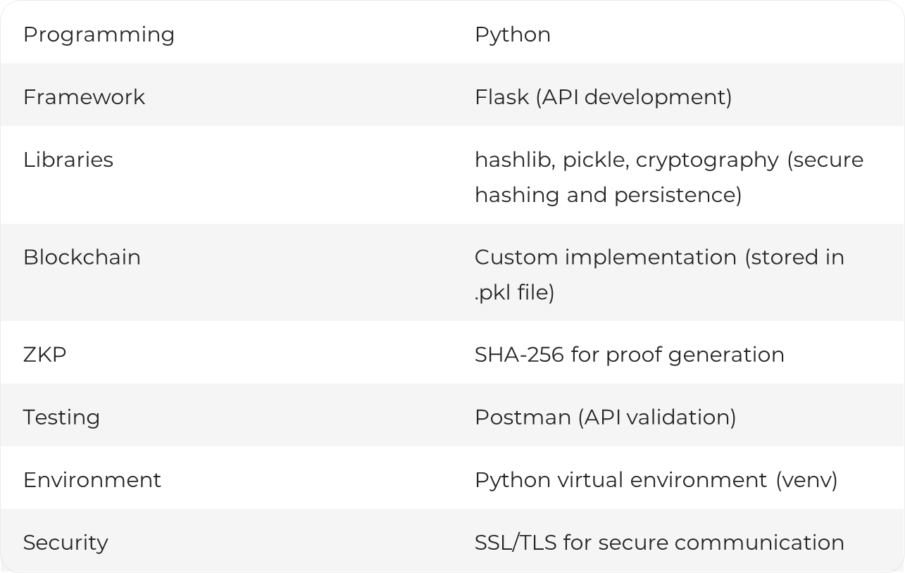
Technologies Used
This project utilizes a diverse set of technologies and frameworks to achieve its goals. This allows us to leverage the power of blockchain, ZKP, and other tools to ensure a secure and efficient e-voting system.
IT21361654 | Hussain M.R.S | 24-25J-136

Slide 10
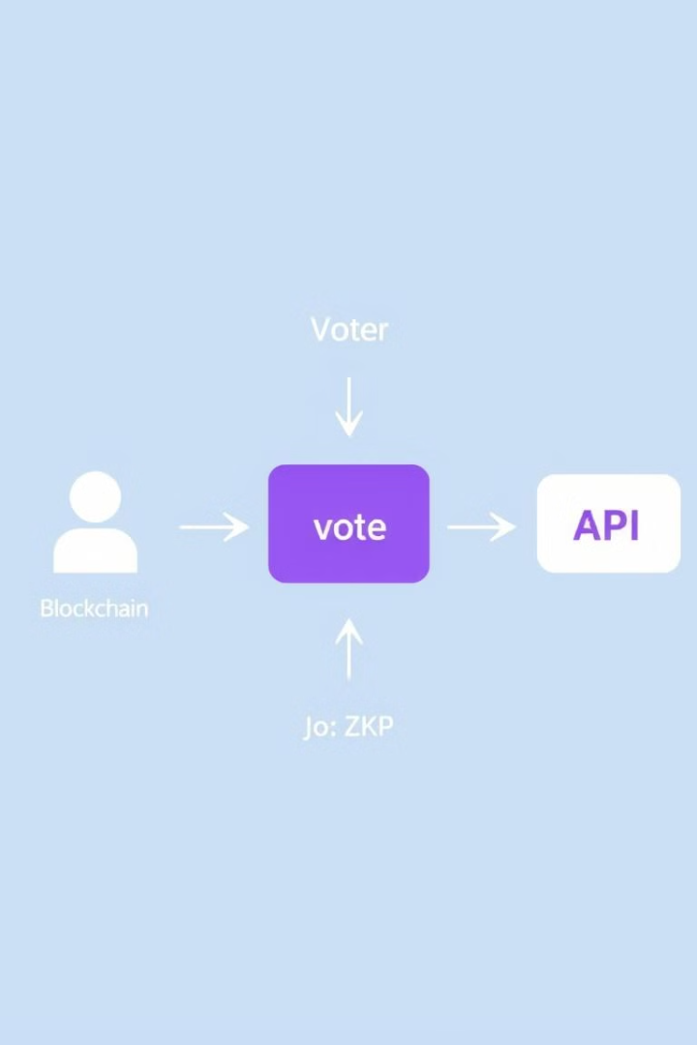




System Architecture
Our e-voting system architecture is designed with modularity and security in mind. This allows for scalability and flexibility, enabling adaptation to different election scenarios.
Voter
Submits vote data.
ZKP
Generates proof of authentication.
Blockchain
Securely stores votes.
API
Provides vote casting and status retrieval.
IT21361654 | Hussain M.R.S | 24-25J-136

Slide 11
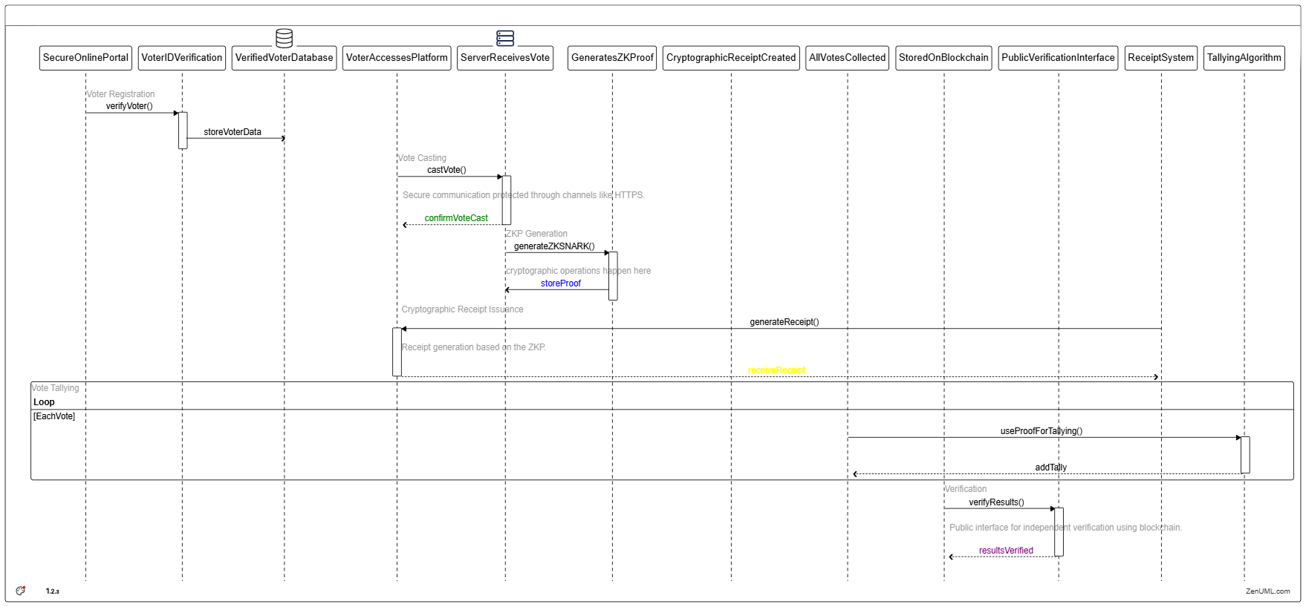
IT21361654 | Hussain M.R.S | 24-25J-136

Slide 12
Methodology
Our project is divided into two phases, each focusing on specific tasks and functionalities. This phased approach allows for incremental progress and early validation of key components.
Phase 1 (Completed)
Phase 2 (Upcoming)
Developed ZKP module for vote privacy.
Created blockchain for secure vote storage.
Implemented API for vote casting and status checking.
Integrate all Components and add security
Final testing and deployment.
IT21361654 | Hussain M.R.S | 24-25J-136

Slide 13
Results So Far
We've achieved significant milestones in the first phase of our project, demonstrating the feasibility and effectiveness of our approach. Our system has already implemented essential functionalities for a secure and transparent e-voting platform.
ZKP Integration
Successful implementation of ZKP for voter authentication.
Blockchain
Secure storage of votes on a custom blockchain.
API
HTTPS-secured Flask API for vote casting and retrieval.
IT21361654 | Hussain M.R.S | 24-25J-136

Slide 14
Challenges and Future Work
While we have made significant progress, there are still challenges to address as we move forward. We are developing strategies to overcome these obstacles and further enhance the security and scalability of our e-voting system.
Security
Performance
Preventing duplicate votes and ensuring scalability for large elections.
Optimizing ZKP proof generation and blockchain query efficiency.
IT21361654 | Hussain M.R.S | 24-25J-136

Slide 15
Completion of the Project
Hardware Costs: Secure servers and blockchain infrastructure setup.
Miscellaneous Costs: Testing, documentation, and dissemination of results.
Commercialization
Budget
Plan to commercialize the developed e-voting system by partnering with election commissions and government agencies.
Market the solution as a secure, transparent, and efficient e-voting platform for large-scale elections.
IT21361654 | Hussain M.R.S | 24-25J-136

Slide 16
REFERENCES
E. Ben-Sasson, A. Chiesa, E. Tromer, and M. Virza, "Scalable Zero-Knowledge via Cycles of Elliptic Curves," Advances in Cryptology – CRYPTO 2014, 2014, pp. 276-294..
S. Majumder, "Design and Implementation of an E-Voting System," ScienceDirect, 2021. [Online]. Available: https://www.sciencedirect.com/science/article/abs/pii/S0306457321000947.
S. Setty, "Spartan: Efficient and general-purpose zkSNARKs without trusted setup," in Proceedings of the 2019 ACM SIGSAC Conference on Computer and Communications Security (CCS '19), 2019, pp. 1317-1334.
E. Ben-Sasson, A. Chiesa, E. Goren, and S. Vadhan, "Scalable Transparent Proofs," IEEE Transactions on Information Theory, vol. 60, no. 12, pp. 6972-6992, Dec. 2014, doi: 10.1109/TIT.2014.2364747
IT21361654 | Hussain M.R.S | 24-25J-136

Slide 17

IT21318252 | Rafeek A.M
Dynamic Taint Analysis Framework for Secure i-Voting Systems.
Cyber Security
IT21318252 | Rafeek A.M | 24-25J-136

Slide 18
Research problem
Current i-voting systems are vulnerable to:
Data tampering during transit.
Malware injections into sensitive data flows.
Bypassing of critical validations.
Problem statement
There is no real-time mechanism to track, validate, and monitor the flow of sensitive data in i-voting systems.
IT21318252 | Rafeek A.M | 24-25J-136

Slide 19
Research gap
Following are the existing approaches.
Focus on static analysis, which lacks runtime monitoring.
Fail to provide a scalable, dynamic solution for large-scale voting systems.
Gap
A lack of real-time dynamic taint analysis for detecting unauthorized data flows in i-voting systems.
IT21318252 | Rafeek A.M | 24-25J-136

Slide 20
Primary Objective
Develop a framework using dynamic taint analysis to ensure secure data flows in i-voting systems.
Sub Objective
Implement Taint Modules for marking sensitive inputs.
Monitor data flows with Explicit Propagation Tracking.
Detect anomalies with Control Flow Graphs (CFGs).
Integrate visualization for better understanding and auditing.
IT21318252 | Rafeek A.M | 24-25J-136

Slide 21
Architecture
The architecture is modular and designed for real-time detection of unauthorized data flows.
Key Components
Taint Module: Marks user inputs as tainted for real-time tracking.
Explicit Propagation Tracking: Monitors data transformations to ensure taint flow integrity.
Control Flow Graphs (CFGs): Visualize data flows and highlight anomalies dynamically.
Validation and Logging: Ensures data integrity and tracks taint-related events.
IT21318252 | Rafeek A.M | 24-25J-136

Slide 22
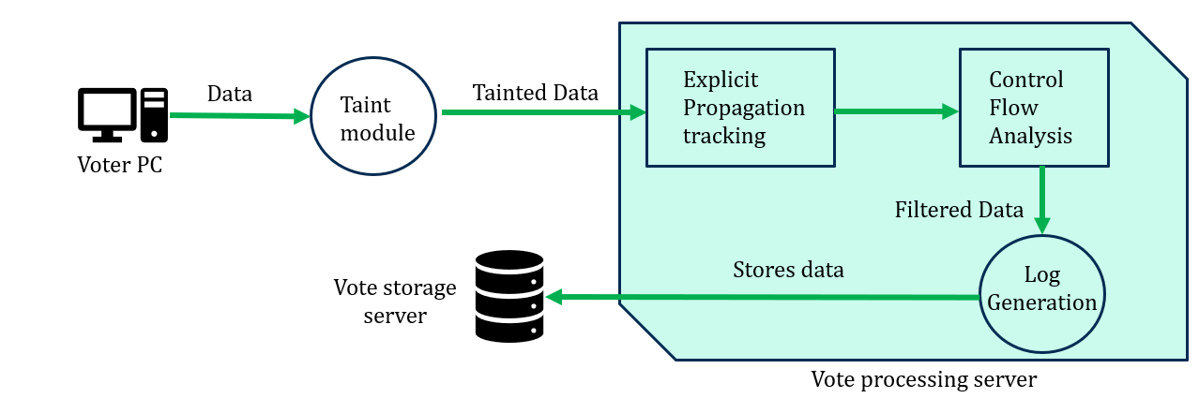
Architecture
IT21318252 | Rafeek A.M | 24-25J-136

Slide 23
Technologies used
Dynamic Taint Analysis Implementation: Python.
Control Flow Graph (CFG): NetworkX for building and visualizing directed graphs.
Visualization: Matplotlib for taint flow graphical representation.
Development Environment: VS Code as the primary IDE for coding and debugging.
Methodology
Phase 1 (Completed)
Phase 2 (Upcoming)
Developed a threat model to identify possible attacks.
Developed taint module to mark input data as taints.
Integrated and status checking. explicit taint tracking to track taint during transformations.
Developed CFGs to visualize taint flow and detect anomalies
Integrate all Components and add security.
Final testing and deployment.
IT21318252 | Rafeek A.M | 24-25J-136

Slide 24
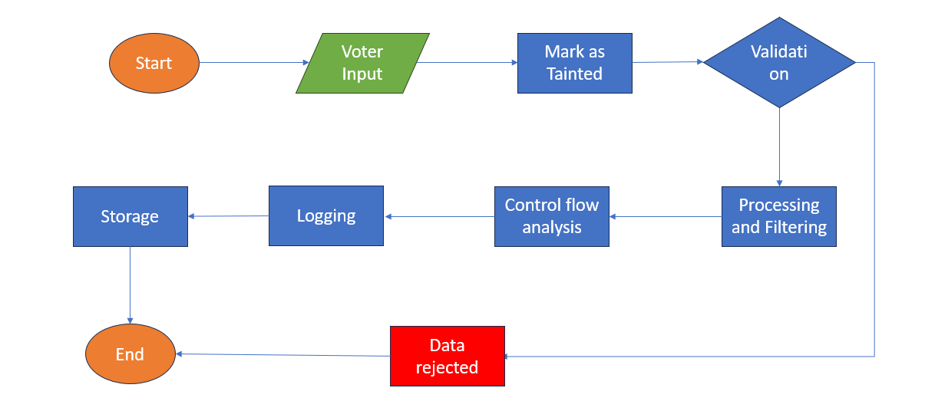
Flowchart
IT21318252 | Rafeek A.M | 24-25J-136

Slide 25
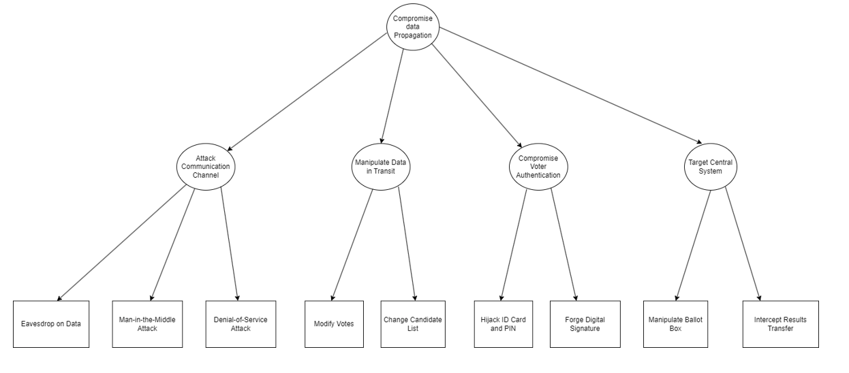
Threat model
IT21318252 | Rafeek A.M | 24-25J-136

Slide 26
Results So Far
Taint Module:
Implemented to mark user inputs as tainted.
Tracks input through various transformations.
Explicit Propagation Tracking:
Dynamically tracks tainted data flow and validates it.
Control Flow Graphs (CFGs):
Developed to visualize taint flow and detect anomalies.
Testing Scenarios:
Valid input: Passed validation and sanitized.
Invalid input: Detected and rejected.
IT21318252 | Rafeek A.M | 24-25J-136

Slide 27
Why dynamic taint analysis?
Unique combination of Explicit Propagation Tracking and Control Flow Analysis for enhanced security.
Real-time detection and prevention of unauthorized data flows.
Detailed data flow logs for thorough auditing
Budget
Infrastructure cost
Servers – Microsoft Azure (Free)
IT21318252 | Rafeek A.M | 24-25J-136

Slide 28
References
J. Newsome and D. Song, "Dynamic Taint Analysis for Automatic Detection, Analysis, and Signature Generation of Exploits on Commodity Software," Carnegie Mellon University, 2005.
K. Hough and J. Bell, "A Practical Approach for Dynamic Taint Tracking with Control-flow Relationships," ACM Transactions on Software Engineering and Methodology, vol. 31, no. 2, pp. 1–43, Dec. 2021, doi: 10.1145/3485464.
S. Heiberg and J. Willemson, "Modeling Threats of a Voting Method," in Electronic Voting: Overview and Threat Analysis, Jan. 2014, doi: 10.4018/978-1-4666-5820-2.ch007.
IT21318252 | Rafeek A.M | 24-25J-136

Slide 29

IT21278976 | PERERA U.L.S.A
Implementing Homomorphic Encryption
Cyber Security
IT21278976 | Perera U.L.S.A | 24-25J-136

Slide 30

Introduction - Research Problem
Current voting systems often fall short in providing comprehensive privacy and security due to their reliance on decrypting votes for tallying, which can expose voter choices to potential breaches. They lack the ability to perform secure computations on encrypted data, leaving them vulnerable to tampering during the tallying process.
Lack of Privacy and Data Protection
Exposure During Vote Tallying
Vulnerability to Tampering
IT21278976 | Perera U.L.S.A | 24-25J-136

Slide 31
Introduction - Specific and Sub Objectives
Integrate homomorphic encryption with
zero- knowledge proofs for secure, transparent voting while preserving voter privacy and ensuring long- term data integrity
Objective
IT21278976 | Perera U.L.S.A | 24-25J-136

Slide 32
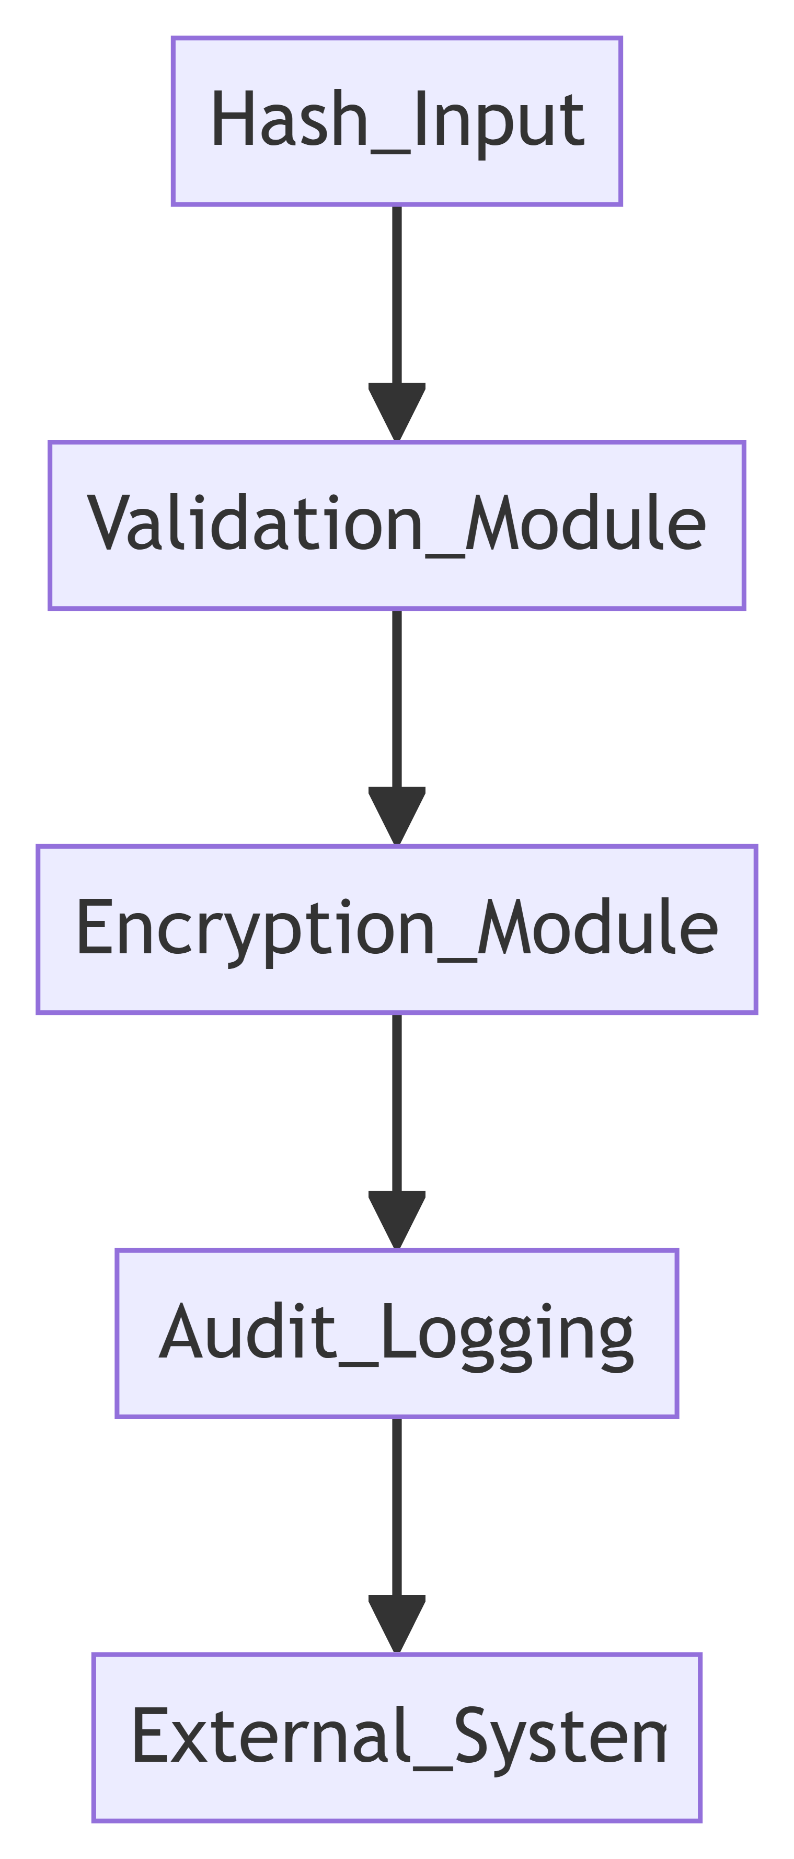
Methodology - System Diagram
Vote tallying process
IT21278976 | Perera U.L.S.A | 24-25J-136

Slide 33
Methodology – Technologies To Be Used
Encryption and Cryptography
Software Development
Data Storage and Management
Networking and Security
Homomorphic Encryption Libraries
Microsoft SEAL
HElib
PalisaDE
Python
C++
JavaScript/TypeScript
Databases
PostgreSQL
MongoDB
Cloud Services:
Secure Communication Protocols:
TLS/SSL
VPNs
Security Tools:
Nmap
Wireshark
IT21278976 | Perera U.L.S.A | 24-25J-136

Slide 34

Current Progress
Input Validation - The system securely accepts a hash value, ensuring it adheres to the required format and standards, thereby maintaining the integrity of the data.
Data Encryption - The validated hash is encrypted using a robust homomorphic encryption method, ensuring that the data remains confidential while enabling secure processing for downstream tasks.
Audit Logging - A detailed log of operations, including the original hash, its encrypted version, and a timestamp, is generated and stored. This ensures traceability and supports auditing requirements.
Integration-Ready Backend - The backend is fully prepared to integrate with external systems, enabling seamless interaction with upstream data providers and downstream consumers for real-world deployment scenarios.

Slide 35
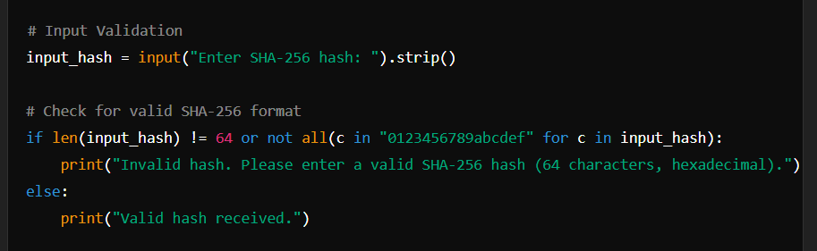
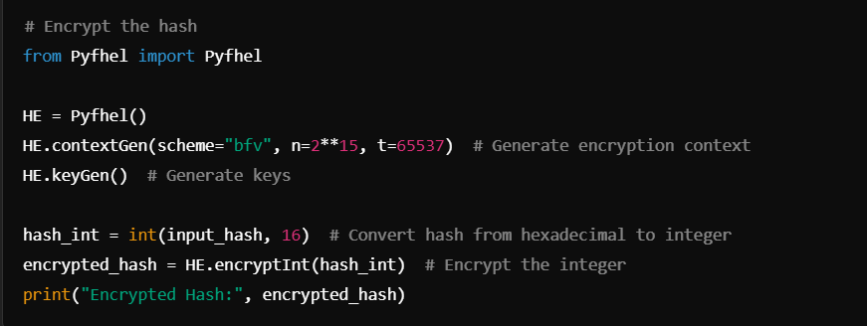
Project Evidence
Input Validation
Hash Validation
IT21278976 | Perera U.L.S.A | 24-25J-136

Slide 36
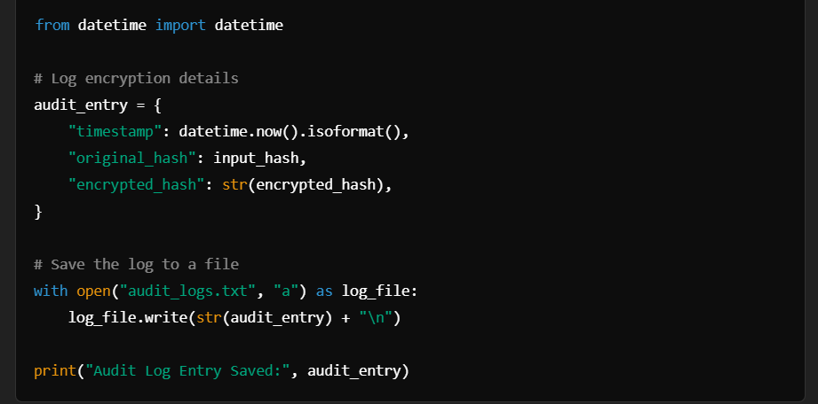
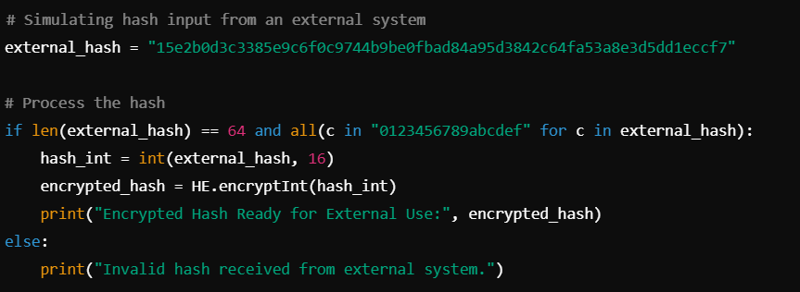
Project Evidence
Audit Logging
Integration Preparedness
IT21278976 | Perera U.L.S.A | 24-25J-136

Slide 37
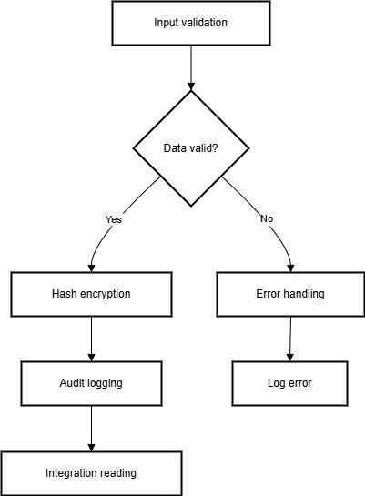
Data flow Diagram
IT21278976 | Perera U.L.S.A | 24-25J-136

Slide 38

Future Work to be Completed
Develop a Frontend - Create a user-friendly interface (e.g., web-based) to input hash values, display encrypted outputs, and show logs.
Integrate with internal Systems: Build APIs to accept hash inputs from external systems and transmit encrypted data to auditing or storage solutions.
Enhance Audit Log Management - Transition to a database for scalable and secure log storage, with features for searching, filtering, and backups.
Testing and Optimization - Conduct thorough testing (unit, integration, load) and optimize encryption performance for high-volume operations.

Slide 39
References
"Secure and Privacy-Preserving Voting System Using Zero-Knowledge Proofs"
Author: Yizhuo Miao
"Lattice-Based Zero-Knowledge Proofs in Action: Applications to Electronic Voting"
Authors: Valeh Farzaliyev, Calvin Pärn, Heleen Saarse, Jan Willemson
"An Electronic Voting System Based on Homomorphic Encryption and Prime Numbers"
Authors: https://ieeexplore.ieee.org/document/7492759
IT21278808 | Perera U.L.S.A | 24 -25J - 020

Slide 40

MPC-Based Vote Handling
IT21303920 | Mushtaq M B M
IT21303920 | Mushtaq M B M | 24-25J-136

Slide 41
Research Problem
Privacy & Trust: Traditional voting systems face challenges in maintaining voter privacy and ensuring trust in the process.
Data Integrity: The integrity of votes can be compromised due to vulnerabilities in traditional systems, susceptible to manipulation or attacks.
IT21303920 | Mushtaq M B M | 24-25J-136

Slide 42
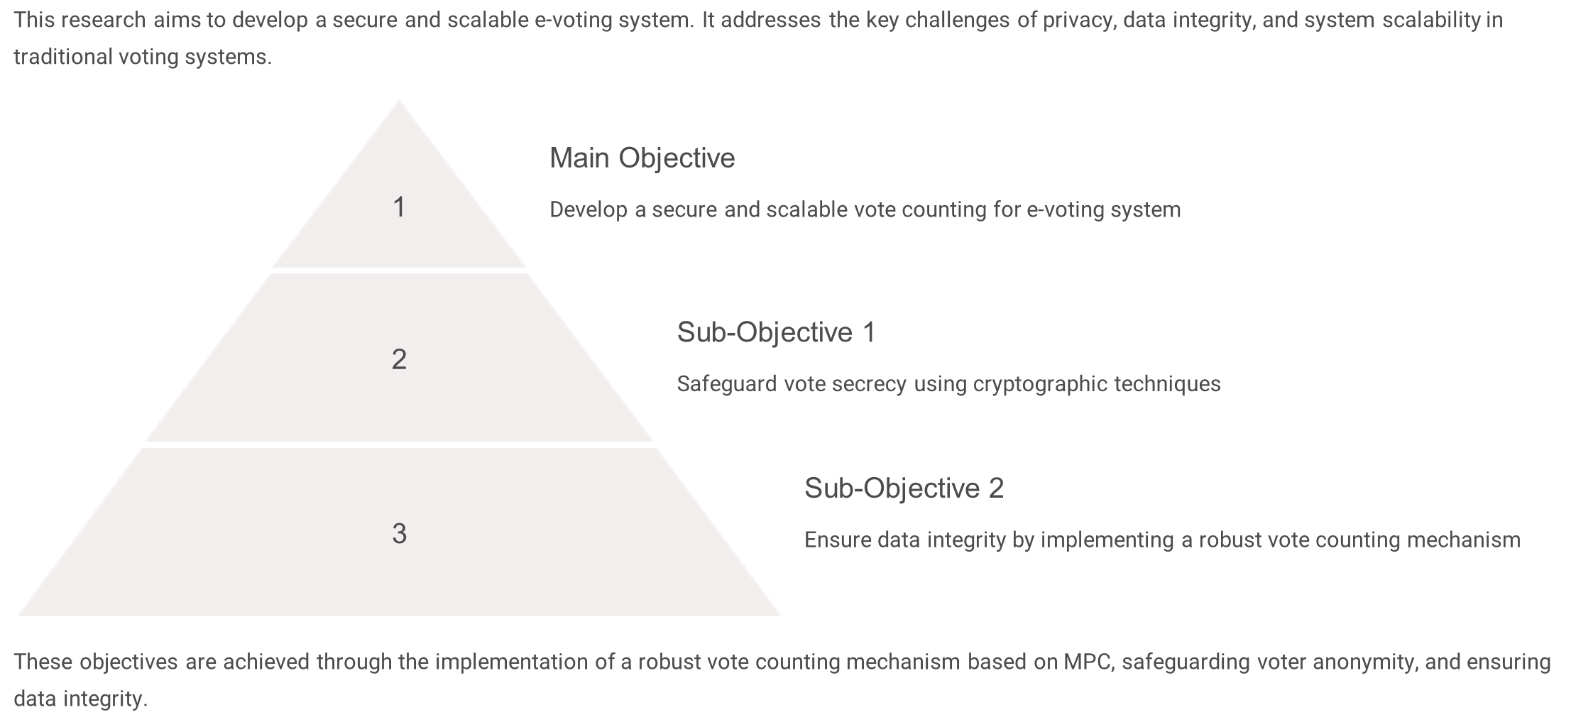
Objectives
IT21303920 | Mushtaq M B M | 24-25J-136

Slide 43
Technologies Used
Programming Languages: Python
Cryptographic Libraries: GMPY2 for modular arithmetic
Multiparty Computation (MPC): Additive Secret Sharing
Concurrency & Parallel Processing: Python's ThreadPoolExecutor
IT21303920 | Mushtaq M B M | 24-25J-136

Slide 44
System Architecture
Modular Design
Secure Vote Counting
The system's modular architecture promotes flexibility and adaptability to various voting scenarios, allowing for seamless integration of new features.
Encapsulation of the vote counting process within a dedicated module ensures secure and reliable vote aggregation, safeguarding the integrity of the election.
IT21303920 | Mushtaq M B M | 24-25J-136

Slide 45
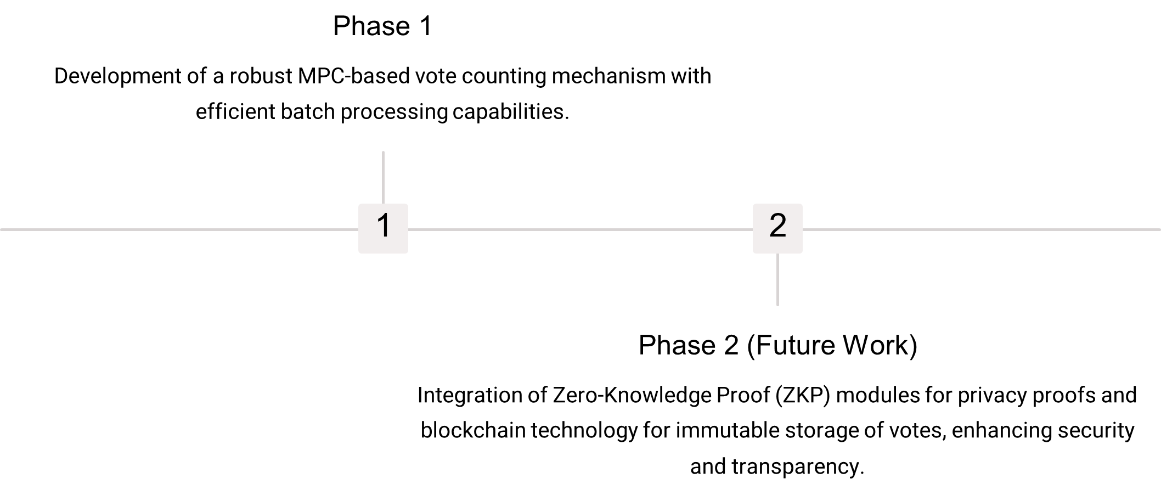
Methodology
IT21303920 | Mushtaq M B M | 24-25J-136

Slide 46
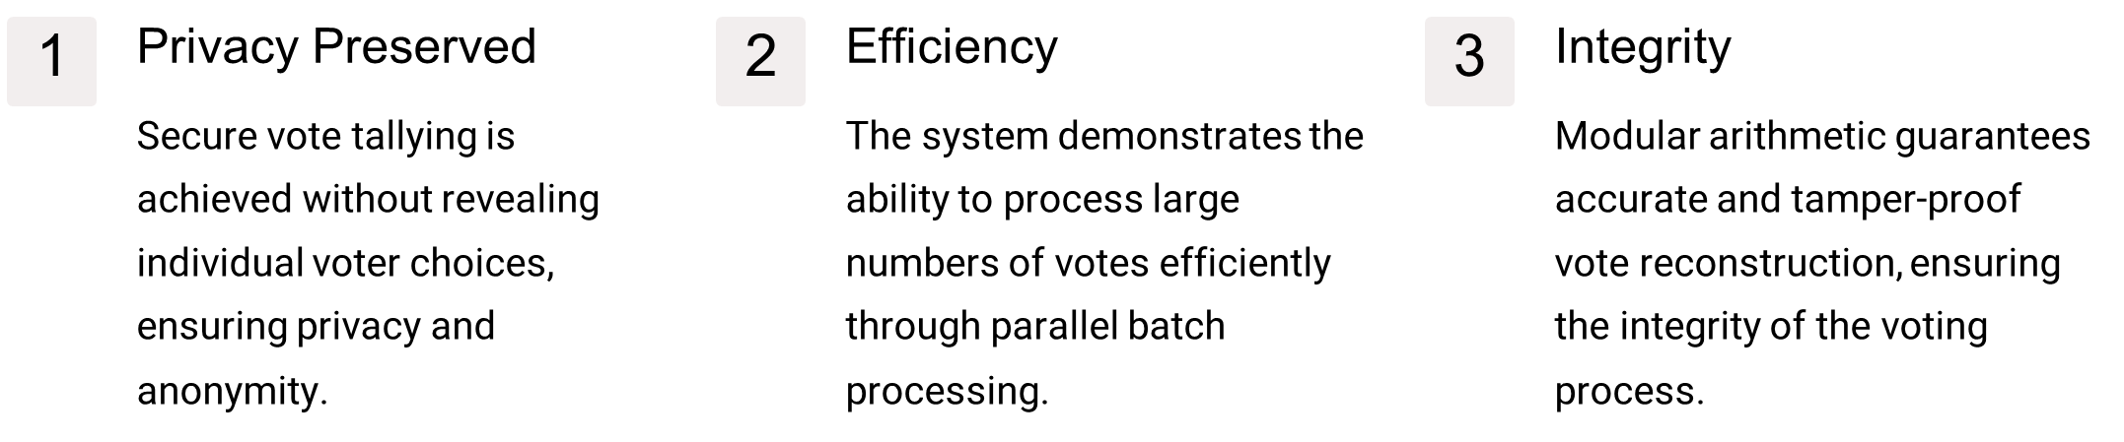
Results So Far
IT21303920 | Mushtaq M B M | 24-25J-136

Slide 47
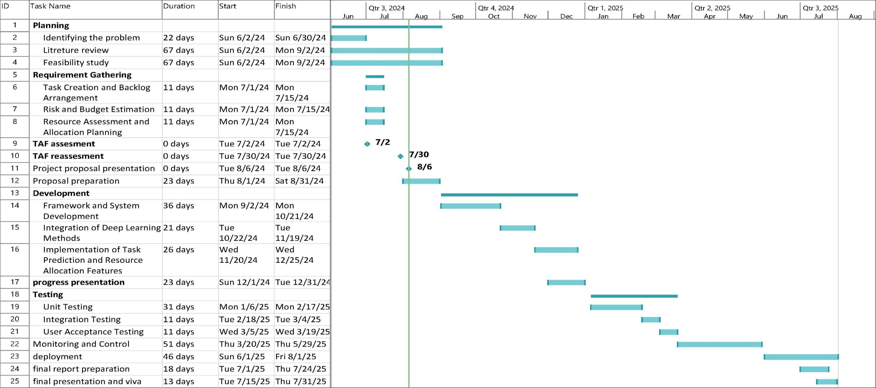
Gannt Chart

Slide 48
Any Questions?

Slide 49

THANK YOU

